Slide 1
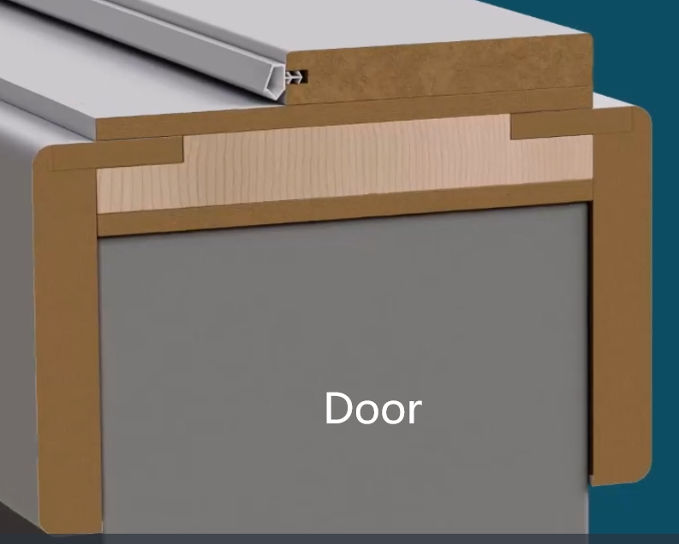
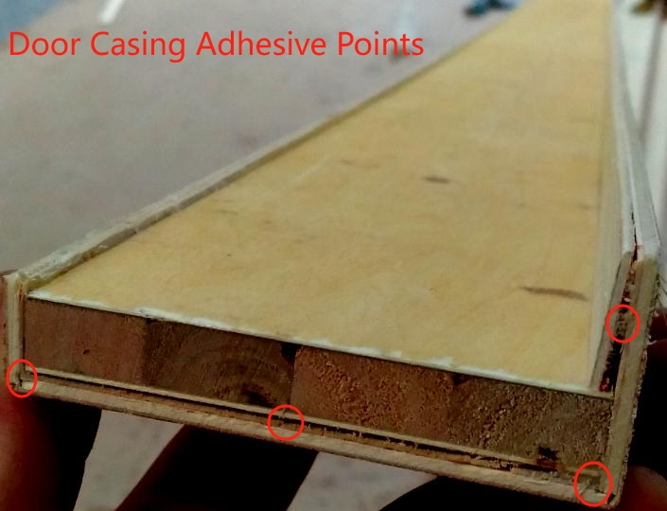
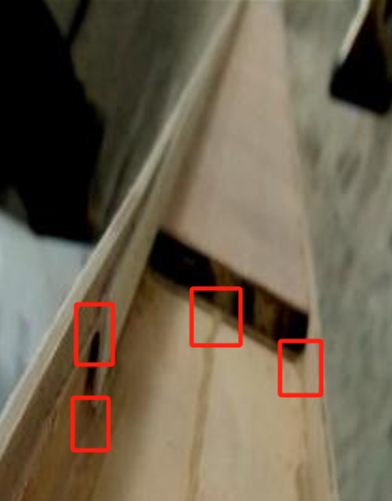
Application Products
Door casing moldings are usually used in combination with door frames. The door frame is the supporting structure of the door, which plays a role in fixing the door body. Door casing moldings are mainly used to cover the gaps between the door frame and the wall, providing sealing and protection.
The "UNISN" hot - melt adhesive for bent moldings is mainly applied to the spray - bonding of solid wood boards, multi - layer solid wood boards, and clips during the production of door casing moldings by wooden furniture manufacturers.

Slide 2
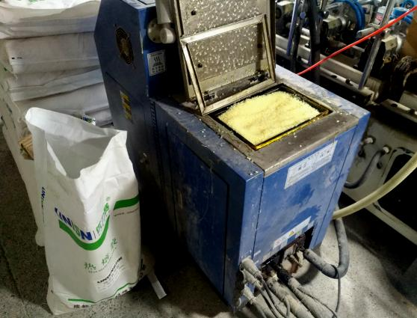
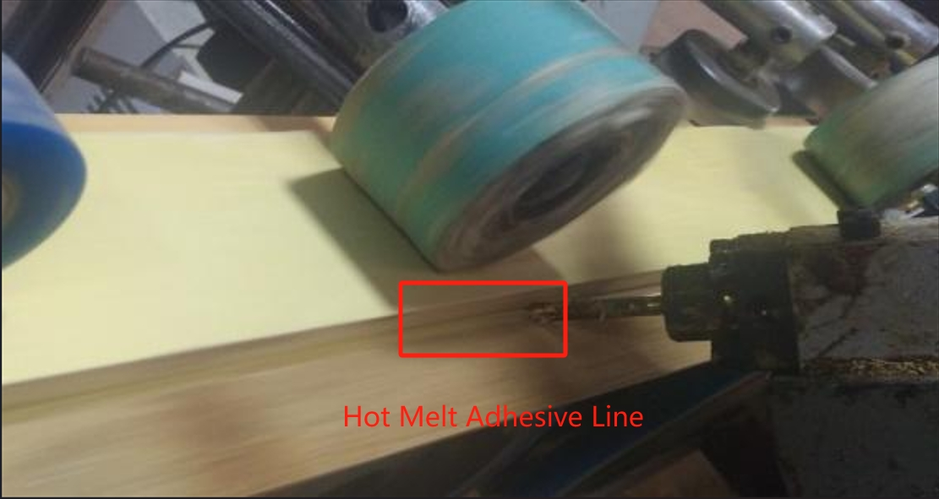
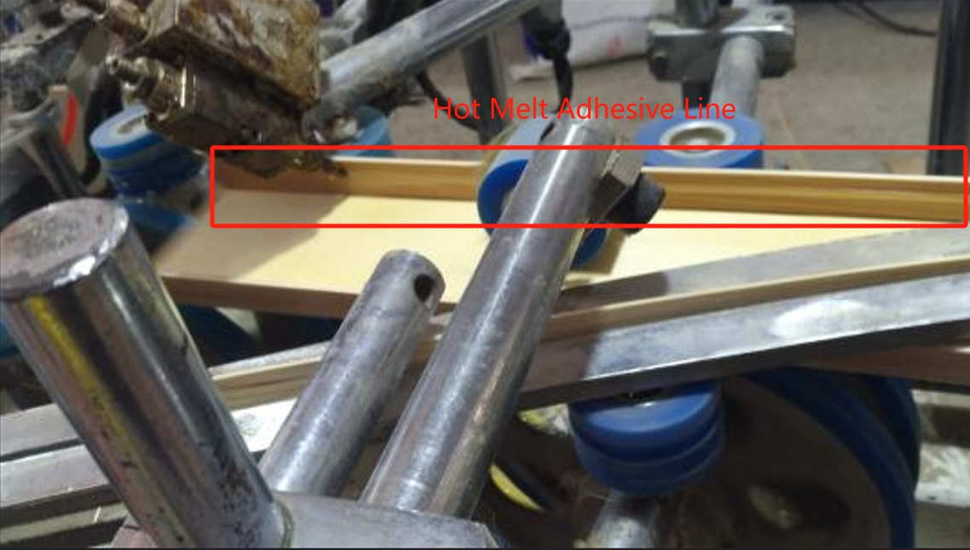
Application Equipment
Most production lines are equipped with one large and one small glue - melting tank. The large glue - melting tank supplies glue to the spray - bonding lines on both sides for bending, while the small glue - melting tank is used for bonding the bottom of the core board and the clips. A few production lines are equipped with two small glue - melting tanks or only one large glue - melting tank
Spray bonding between solid wood boards and multi - layer solid wood boards.
Spray bonding between multi - layer solid wood boards and clips.

Slide 3
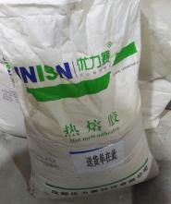
Why Choose UNISN Hot - melt Adhesive
Fast Melting Speed: It can transform from a solid state to a liquid state in a relatively short time, enabling quick use and improving production efficiency.
Good Fluidity: It can be quickly and evenly coated on the surface of the adherend and fit well, ensuring the integrity of the bond.
Fast Curing Speed: It allows the adherends to be fixed rapidly, greatly shortening the production cycle.
High Bonding Strength: It has good bonding performance with various types of wood, ensuring that the bonded objects will not easily fall off or separate.
Good High - Temperature Resistance: It can still maintain good bonding strength and stability in a certain high - temperature environment, making it suitable for high - temperature applications.
Environmentally Friendly and Harmless: It is made from environmentally friendly raw materials, causing no pollution to human health and the environment. It can be widely used in fields with high environmental requirements.

Slide 4
Usage Methods and Precautions
Open Time: 10 - 20 seconds
Operating Temperature Settings: Glue - melting tank: 180 - 200°C; Hose and spray gun: 180 - 190°C.
Note: In cold environments, the hot - melt adhesive dissipates heat quickly, and the operating temperature of the hot - melt adhesive needs to be increased by at least 5°C.
In addition, note the following:
Pre - heat the glue - melting device for about 2 hours first.
Control the amount of glue added according to the production volume to prevent over - heating due to incomplete consumption over a long period, which may cause the glue to age and affect its adhesion. Also, avoid insufficient consumables, which may affect glue spraying.
After replenishing consumables, reseal the packaging bag and cover the glue - melting tank to prevent impurities from mixing in and blocking the hose and spray gun.
The bonding work must be completed within the open time of the glue. Clamp the adherends until they are completely cooled and cured.
Since the glue - melting tank and the glue - spraying system are at high temperatures, safety protective equipment must be worn during operation to prevent burns.
Avoid contact between the melted glue and parts such as eyes and skin.
If the melted glue comes into contact with the skin, immediately immerse the affected skin in cold water and rinse for at least 10 minutes. Seek medical treatment in a timely manner after cooling.

Slide 5
FAQ
Production Anomaly | Cause Analysis | Solutions
No glue spraying, uneven glue spraying | Incomplete glue melting | Increase the glue - melting temperature and extend the glue - melting time (wait)
 | Insufficient glue pump pressure, under - pressure in the air pressure valve | Check the glue pump frequency, air pressure, and whether the pipeline is damaged or detached
 | Fluctuation of the glue volume regulating valve | Check and reinforce it
 | Blockage in the glue - supply or glue - spraying system | Dredge, clean, and remove impurities or carbonized substances
Insufficient bonding strength | Glue rupture from the second base surface | Increase the glue amount, raise the operating temperature, and increase the bonding pressure
 | Glue layer rupture from the first base surface | Raise the operating temperature and check the substrate
 | Insufficient glue amount | Check the glue amount adjustment switch, increase the glue - spraying amount, and ensure a small amount of overflow
 | Internal cohesion rupture of the glue, brittle glue, poor high and low - temperature resistance | Raise the operating temperature, enhance the internal cohesion of the hot - melt adhesive, and improve the softening point

Slide 6
FAQ
Production Anomaly | Cause Analysis | Solutions
Poor adhesion of supplementary clips | Low temperature, insufficient penetration | Increase the temperature
 | Insufficient or uneven glue amount | Check the glue amount adjustment switch and increase the glue - spraying amount
 | The glue has cured or semi - cured before leaving the equipment | Attach the clips before leaving the equipment and increase the temperature of the glue used for the clips
 | Short open time of the hot - melt adhesive | Extend the open time of the hot - melt adhesive
Smoke from the hot - melt adhesive | Too high operating temperature | Lower the operating temperature
 | Malfunction of the glue machine temperature control | Check the glue temperature, replace the malfunctioning components, and contact the equipment manufacturer

Slide 7
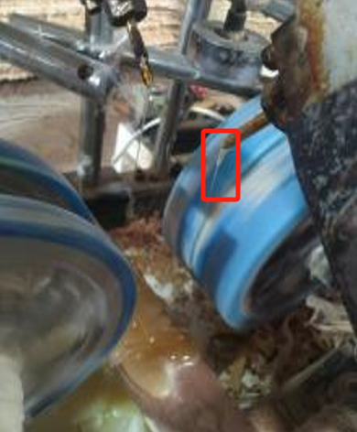
FAQ
Production Anomaly | Cause Analysis | Solutions
Glue dripping, glue flowing | Foreign matter in the spray glue valve, improper closing | Inspect, repair, or replace
 | Too large spray nozzle | Replace or reduce the size of the spray nozzle
 | Inappropriate spray nozzle angle | Adjust the angle
 | Too high or too low glue temperature | Check and adjust the temperature
 | Unstable air pressure, under - pressure, valve leakage | Check the air pressure valve, supply pressure, and whether the pipeline is damaged or detached
 | Leakage of the glue pump | Contact the glue machine manufacturer for maintenance

Slide 8
Thank You for Your Attention!
Sichuan UNISN New Material Technology Co., Ltd.
Office Address: Room 806, Building 5, China Railway West City Business District, Qingyang District, Chengdu,
Sichuan Province,
China
Tel: +86 028-81726336 Fax: +86 028-81766336
Mobile: +86 138 8208 4297 Email: unisn@foxmail.com

